Slide 1

Automatic Vending Machine For Instant Mini Pizza CSC-1100
Presented To:
Dr. SURIANI BT. SULAIMAN
Section: 02
Prepared By:
Team N-N
1. Zannat Nahreen - 1632738
2. NOWSHIN NADIA - 1714160
3. Hasan MD. Tanvir – 1716763
4. Jaki Fayek Alvi Rahman – 1721485

Slide 2
Description:
Our program lets user to order instant mini pizza for customers.
The Input has to go through some tests to make sure it’s Valid.
The programs save and show previous purchase using a file named “Sales.dat”.
You can check remaining item’s amounts, price, purchase history through the file.(Allowed to the managers only)
Managers can check the amount and refill the items using “PizzaCapacity.dat”, “ToppingsCapacity.dat”, “SauceCapacity.dat”.
Customers can insert money to buy pizza. Otherwise the program will show “There is not enough money”

Slide 3
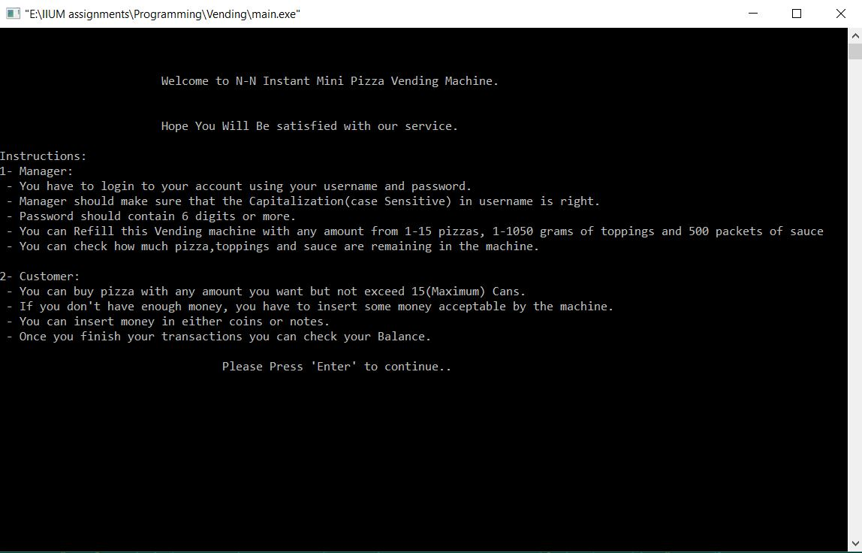
Topics We Have Covered
Input & Output
Select & Repetition
Functions
Arrays[1D]
Files
Pointers
External file

Slide 4
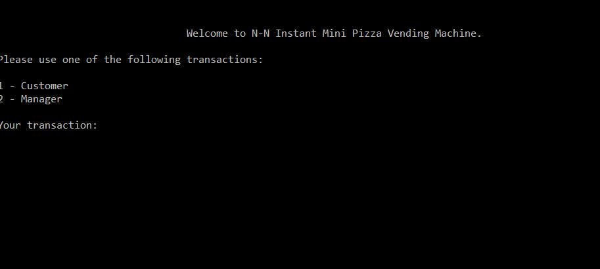
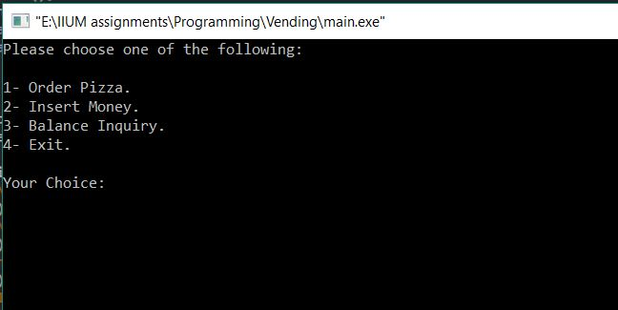
Main Menu Screens:
Dealing With Two Parts In This Program
A) Customer
B) Manager
Customer Menu Has -
A) Order Pizza
B) Insert Money
c) Balance Inquiry
D) Exit (endOfProgram)

Slide 5
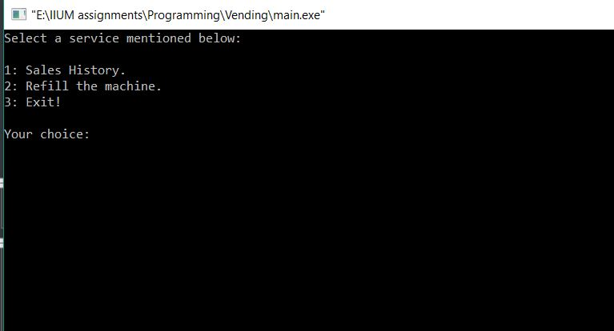
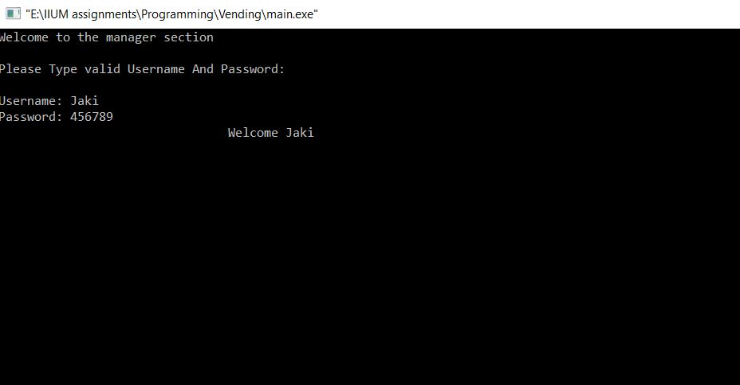
Main Menu Screens(contd.):
Manager Menu Has-
Sales History
Refill the machine
Exit (endOfProgram)
Manager Has To Enter Valid Username
and PassWord
Otherwise it will show Invalid Input

Slide 6
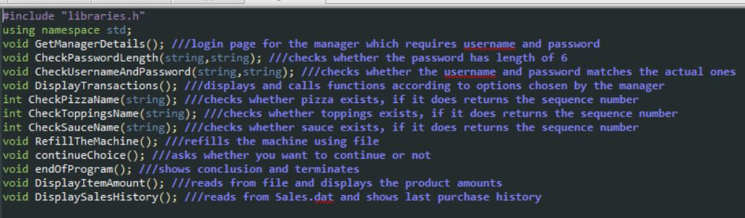
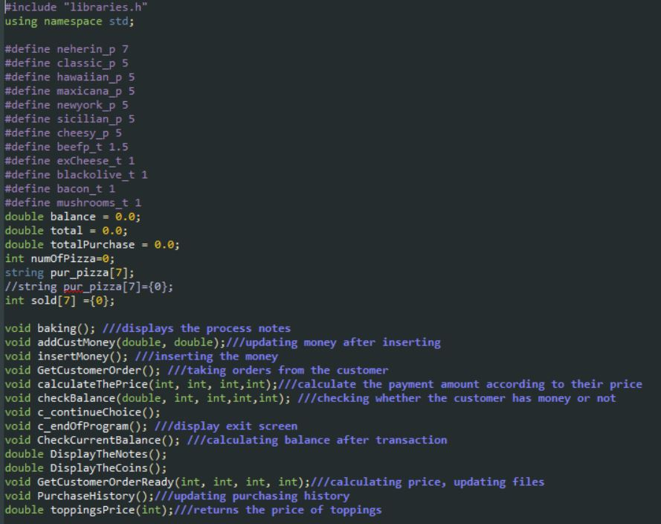
Our External Header “manager.h” has-
12 functions
Our External Header “customer.h” has-
14 functions
Globally declared variables

Slide 7
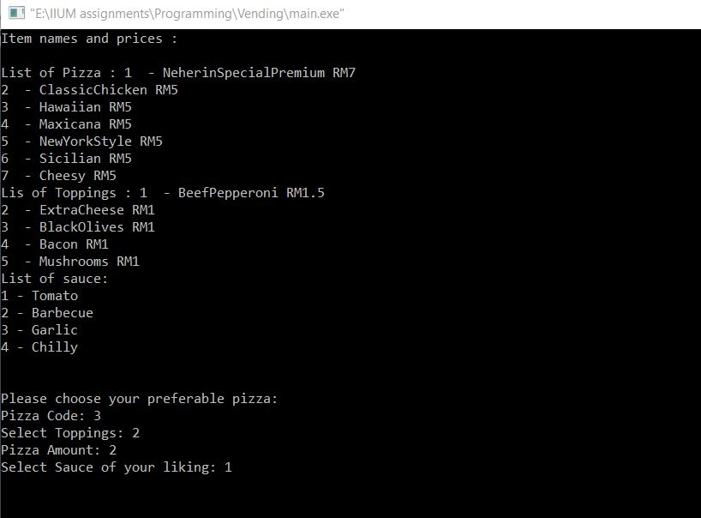
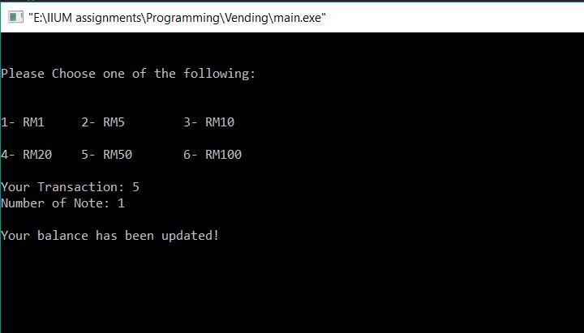
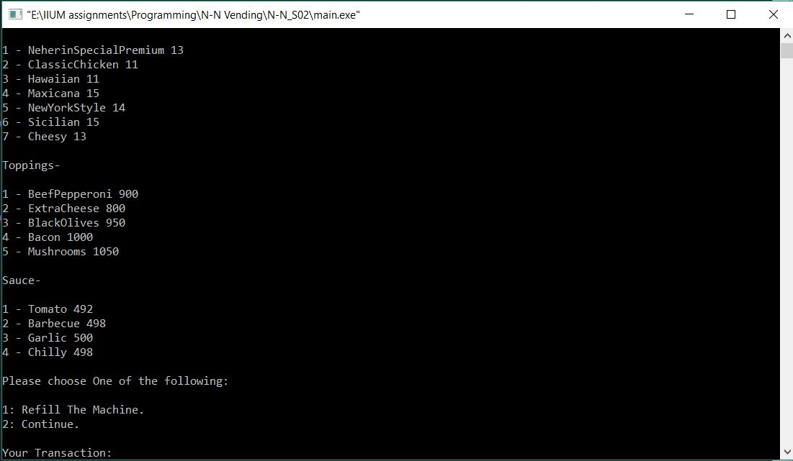
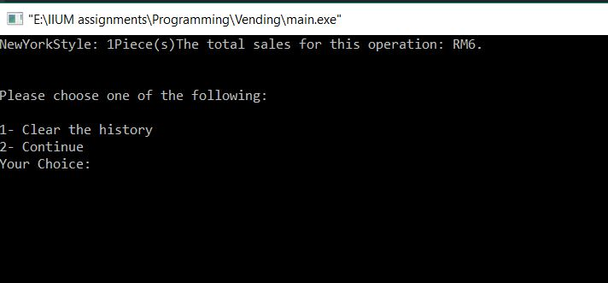

Slide 8
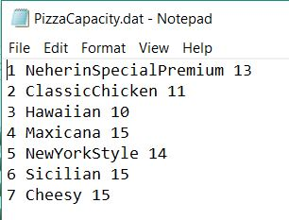
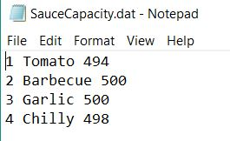
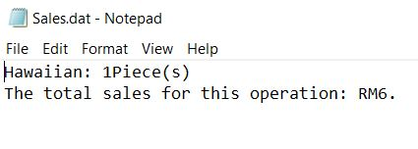
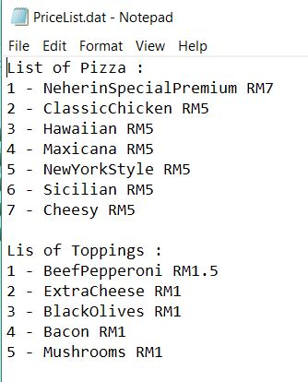
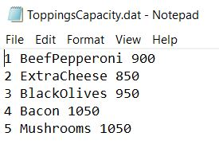
Files Used in The Program:

